Slide 1
OO Principles Inheritance
Elizabeth Bourke

Slide 2
Inheritance: Definition
inheritance: a parent-child relationship between classes ..
allows sharing of the behavior of the parent class into its child classes, one of the major benefits of object-oriented programming (OOP) is this code sharing between classes through inheritance
child class can add new behavior or override existing behavior from parent

Slide 3
Inheritance terms
superclass, base class, parent class: terms to describe the parent in the relationship, which shares its functionality
subclass, derived class, child class: terms to describe the child in the relationship, which accepts functionality from its parent
Inheritance implements “a-kind-of” relationship
Inheritance means that a class (the derived class) may be defined that inherits the characteristics (data members and member functions) of a previously defined class (the base class).

Slide 4
Inheritance terms
Inheritance should allow inheritance of private members of the base class.
The derived class may define additional data members and add or re-define member functions.
Inheritance is implemented by the mechanism of ‘class derivation’.
In application development a class hierarchy is often defined with the base class forming the root of the hierarchy.
As one moves down through the hierarchy one moves from generalization to specialization.

Slide 5
Methods of the System.Object class
Supports all classes in the .NET Framework class hierarchy..
All objects are derived from the System.Object class

Slide 6
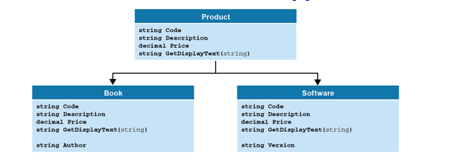
Product Example

Slide 7
Class hierarchy
In implementing a class hierarchy, the base class has a set of data members that will be required by objects of any class in the hierarchy.
Add these data members as protected. This means that they are public to derived classes, but private to all else.
Add member functions that can be used with an object of any class in the hierarchy.
Add implementation code to functions if appropriate or leave undefined.
virtual functions - If you want a derived class to be able to override one of the members of the base class, you include the virtual keyword on the declaration.

Slide 8
The syntax for creating subclasses

Slide 9
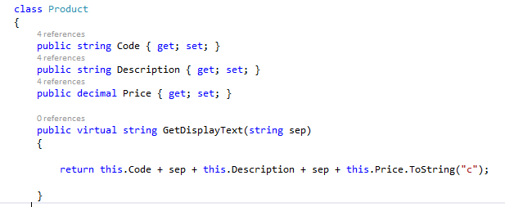
Product base class
allow for it to be overridden in a derived class.. Derived class must define use override in function heading .. More later..

Slide 10
The code for a Book class

Slide 11
The code for the Software class

Slide 12
Three versions of the GetDisplayText method

Slide 13
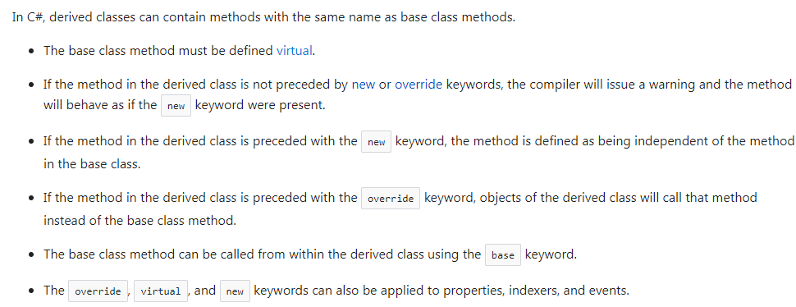
Virtual Methods

Slide 14
Code that uses the overridden methods

